Slide 1
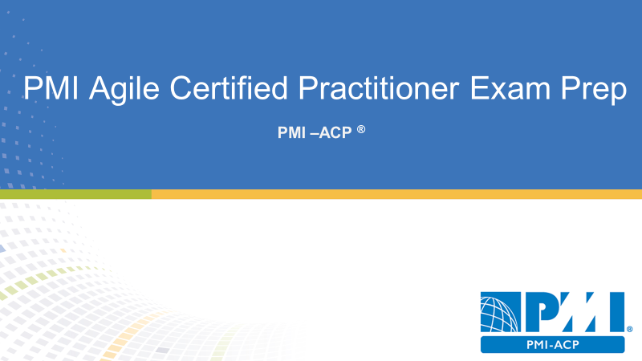
Introduction

Slide 2

Agenda
PMI-ACP Exam Overview
PMI-ACP Examination Details
PMI-ACP Examination Domains, Tools & Techniques, Knowledge & Skills

Slide 3

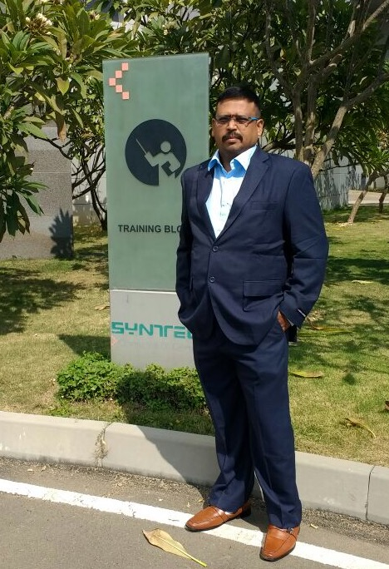


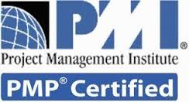






Agile Certified Professional
Sriram Balasubramanian

Slide 4
PMI-ACP Exam Overview
Overview

Slide 5
PMI-ACP Exam overview
Agile is a topic of growing importance in project management. The marketplace reflects this importance, as project management practitioners increasingly embrace agile as a technique for managing successful projects.
The PMI-ACP certification recognizes an individual’s expertise in using agile practices in their projects, while demonstrating their increased professional versatility through agile tools and techniques.
In addition, the PMI-ACP certification carries a higher level of professional credibility as it requires a combination of agile training, experience working on agile projects, and examination on agile principles, practices, tools, and techniques. This global certification also supports individuals in meeting the needs of organizations that rely on project practitioners to apply a diversity of methods to their project management.

Slide 6
PMI-Agile Certified Practitioner® Exam Prep Topics
PMI-ACP Course Introduction
Domain – I Agile Framework
Domain – II Value Driven Delivery
Domain – III Stakeholder Engagement
Domain – IV Boosting Team Performance Practices
Domain – V Adaptive Planning
Domain – VI Problem Detection and Resolution
Domain – VII Continuous Improvement

Slide 7
PMI-ACP Examination Details
Handbook

Slide 8
PMI-ACP Exam Pre-requisites
• 2,000 hours of general project experience
• PMPs and PgMPs qualify for this requirement
• 1,500 hours working on agile project team or agile methodologies
• 21 contact hours of training in agile practices
• Yes, this course satisfies this objective

Slide 9
PMI-ACP Exam Fees
PMI Member: $435
• Non-member: $495
• Cost to join PMI: $129 plus $10 application fee

Slide 10
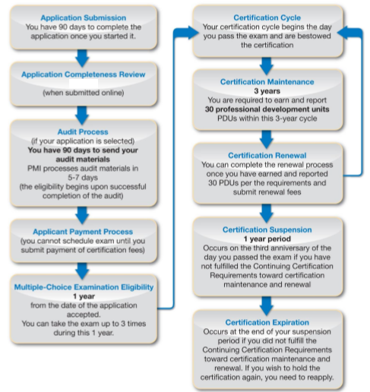
PMI-ACP Certification Process

Slide 11
PMI-ACP Application Process
90 days to complete the application once started
PMI reviews your application (up to 10 days)
Pay for the exam
• Potential audit – 90 days max to complete
Exam qualification – 1 year to complete exam
Certification cycle
3-year cycle
30 PDUs needed on agile

Slide 12
PMI-ACP Random Audits
You’ll mail to PMI:
Copies of your diploma/global equivalent
Signatures from your supervisor(s) or manager(s) from the project(s) recorded in the experience verification section of the application
Copies of certificates and/or letters of registration, from the training institute(s) for each course recorded on the application to meet the required contact hours of training in agile practices

Slide 13
PMI-ACP Exam Details
Total questions: 120
- 100 scored test questions
- 20 unscored test questions
Total Duration: 3 hours

Slide 14
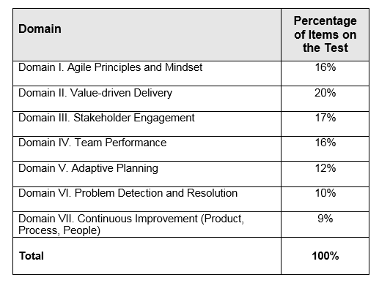
PMI-ACP Exam Blue Print

Slide 15
PMI-ACP Test Center Details
Computer-Based Test (CBT)
Paper-Based Test (PBT)
- At least 300 Km from a Prometric CBT site
- PBT’s must have at least 10 participants

Slide 16
How to Schedule the CBT Exam
Schedule your appointment online at the Prometric website.
Select Schedule my test.
Select your geographical location from the dropdown menu, and click Next.
Read through the examination information presented on your screen, and click Next.
Read through and agree to the Policies and Data Privacy Notice
Enter your unique PMI Eligibility ID (the number ending with an “E” located on your scheduling notification) and the first four letters of your last name (as they appear on your government-issued identification). Click Next.
Use the tool provided to search for testing sites in your area. Select Schedule an Appointment.

Slide 17
How to Schedule the CBT Exam
Locate and select your exam date and time. Available dates will appear in blue on the calendar, and dates with no appointments available will be in grey. Select your date from the calendar provided, and then your time. Click Next.
Confirm your contact information and provide a valid email address. Please note, the email address provided will be the email to which your examination confirmation will be sent. Once your information is entered and confirmed, click Next.
Review your final appointment details, and then click Complete Appointment. Your appointment will not be scheduled until you click Complete Appointment.
Your examination confirmation, along with your 16 digit unique confirmation number, will be displayed. This information will also be sent via email to the address provided.

Slide 18
How to Schedule the PBT Exam
If you qualified to take a paper-based examination, you will not have to do anything to schedule a PBT appointment after you have successfully submitted your examination payment. Candidates sitting for a paper-based administration submit their examination registration along with the examination payment. Once your payment is submitted, you will receive a confirmation notice confirming the details of the event you have registered for.
Approximately 20 days before the date of the event, you will receive an additional notification containing your final testing site instructions. This confirmation will containing your eligibility dates, your examination date and location, your arrival times, information on what to bring to the testing site and a contact person.

Slide 19
Rescheduling | Cancelling PMI-ACP Exam
Within 30 days: $70
Within 2 days: Forfeit Fee
No-show is a forfeiture
Emergencies: PMI will determine if the emergency qualifies
Work emergencies don’t qualify as an emergency
Personal emergencies are only considered

Slide 20
PMI-ACP Testing Center Details
The following are acceptable forms of government-issued identification:
Valid driver’s license
Valid military ID
Valid passport
Valid national identification card
The following are acceptable forms of secondary identification:
Valid employee ID
Valid credit card with signature
Valid bank (ATM) card
The following are not acceptable forms of identification:
Social Security cards
Library cards

Slide 21
PMI-ACP Testing Center Process
Arrive 30 minutes before the exam starting time
You will be assigned a locker for your belongings
Nothing can go into the testing center with you
Sweaters and coats can be worn, but not removed
The Testing Center Administrator will ask you to remove your pockets and roll up your sleeves, and will scan you with a metal detecting wand
Booklet of scratch paper and two pencils or Dry erase board and market
Calculator (Available in Exam Software)
Ear Plugs or Headphones available

Slide 22
PMI-ACP Testing Center Details
Can take a break
Cannot access locket
No Pause in the exam timer
You can get booted for:-
Disruptions
Trying to cheat
Trying to keep scrap paper (Even Tearing)
Eating or drinking in testing room
Attempting to tamper with computer
Being a moron

Slide 23
PMI-ACP Examination Report
CBT report the Pass / Fail immediately after survey
PMI defines the level of “Proficiency” as follows:-
Proficient - Indicates performance is above the average level of knowledge in this domain
Moderately Proficient - Indicates performance that is at average level of knowledge in this domain
Below Proficient - Indicates performance is below the average level of knowledge in this domain
PMI does not say what the passing score is

Slide 24
PMI-ACP Examination Domains, Tools &Techniques, Knowledge & Skills
Content Outline

Slide 25
PMI-ACP Examination Domains & Tasks
Domains and Tasks
Domains are categories of knowledge
Tasks are activities within that domain

Slide 26
PMI-ACP Examination Domains
Domain – I Agile Framework – Principles & Mindset
Domain – II Value Driven Delivery
Domain – III Stakeholder Engagement
Domain – IV Boosting Team Performance Practices
Domain – V Adaptive Planning
Domain – VI Problem Detection and Resolution
Domain – VII Continuous Improvement

Slide 27
PMI-ACP Examination Domains..
Domain I. Agile Principles and Mindset (9 tasks)
Explore, embrace, and apply agile principles and mindset within the context of the project team and organization. 16 percent of exam; roughly 19 questions
Domain II. Value-Driven Delivery (4 sub-domains, 14 tasks)
Deliver valuable results by producing high-value increments for review, early and often, based on stakeholder priorities. Have the stakeholders provide feedback on these increments, and use this feedback to prioritize and improve future increments. 20 percent of exam; 24 questions

Slide 28
PMI-ACP Examination Domains..
Domain III. Stakeholder Engagement (3 sub-domains, 9 tasks)
Engage current and future interested parties by building a trusting environment that aligns their needs and expectations and balances their requests with an understanding of the cost/effort involved. Promote participation and collaboration throughout the project life cycle and provide the tools for effective and informed decision making. 17 percent of exam; 20 questions
Domain IV. Team Performance (3 sub-domains, 9 tasks)
Create an environment of trust, learning, collaboration, and conflict resolution that promotes team self-organization, enhances relationships among team members, and cultivates a culture of high performance. 16 percent of exam; 19 questions

Slide 29
PMI-ACP Examination Domains..
Domain V. Adaptive Planning (3 sub-domains, 10 tasks)
Produce and maintain an evolving plan, from initiation to closure, based on goals, values, risks, constraints, stakeholder feedback, and review findings. 12 percent of exam; 14 questions
Domain VI. Problem Detection and Resolution (5 tasks)
Continuously identify problems, impediments, and risks; prioritize and resolve in a timely manner; monitor and communicate the problem resolution status; and implement process improvements to prevent them from occurring again. 12 percent of exam; 14 questions

Slide 30
PMI-ACP Examination Domains..
Domain VII. Continuous Improvement (Product, Process, People) (6 tasks)
Continuously improve the quality, effectiveness, and value of the product, the process, and the team. 9 percent of exam; 11 questions

Slide 31
Domain I - Agile Principles & Mindset Tasks
Task 1 Advocate for agile principles by modeling those principles and discussing agile values in order to develop a shared mindset across the team as well as between the customer and the team.
Task 2 Help ensure that everyone has a common understanding of the values and principles of agile and a common knowledge around the agile practices and terminology being used in order to work effectively.
Task 3 Support change at the system or organization level by educating the organization and influencing processes, behaviors, and people in order to make the organization more effective and efficient.

Slide 32
Domain I - Agile Principles & Mindset Tasks..
Task 4 Practice visualization by maintaining highly visible information radiators showing real progress and real team performance in order to enhance transparency and trust.
Task 5 Contribute to a safe and trustful team environment by allowing everyone to experiment and make mistakes so that each can learn and continuously improve the way he or she works.
Task 6 Enhance creativity by experimenting with new techniques and process ideas in order to discover more efficient and effective ways of working.
Task 7 Encourage team members to share knowledge by collaborating and working together in order to lower risks around knowledge silos and reduce bottlenecks.

Slide 33
Domain I - Agile Principles & Mindset Tasks..
Task 8 Encourage emergent leadership within the team by establishing a safe and respectful environment in which new approaches can be tried in order to make improvements and foster self-organization and empowerment.
Task 9 Practice servant leadership by supporting and encouraging others in their endeavors so that they can perform at their highest level and continue to improve.

Slide 34
Domain II – Value Driven Delivery Tasks..
Sub Domain: Define Positive Value
Task 1 Define deliverables by identifying units that can be produced incrementally in order to maximize their value to stakeholders while minimizing non-value added work.
Task 2 Refine requirements by gaining consensus on the acceptance criteria for features on a just-in-time basis in order to deliver value.
Task 3 Select and tailor the team’s process based on project and organizational characteristics as well as team experience in order to optimize value delivery

Slide 35
Domain II – Value Driven Delivery Tasks..
Sub Domain: Avoid Potential Downsides
Task 4 Plan for small releasable increments by organizing requirements into minimally marketable features/minimally viable products in order to allow for the early recognition and delivery of value.
Task 5 Limit increment size and increase review frequency with appropriate stakeholders in order to identify and respond to risks early on and at minimal cost.
Task 6 Solicit customer and user feedback by reviewing increments often in order to confirm and enhance business value.

Slide 36
Domain II – Value Driven Delivery Tasks..
Sub Domain: Prioritization
Task 7 Prioritize the units of work through collaboration with stakeholders in order to optimize the value of the deliverables.
Task 8 Perform frequent review and maintenance of the work results by prioritizing and maintaining internal quality in order to reduce the overall cost of incremental development.
Task 9 Continuously identify and prioritize the environmental, operational, and infrastructure factors in order to improve the quality and value of the deliverables

Slide 37
Domain II – Value Driven Delivery Tasks..
Sub Domain: Incremental Development
Task 10 Conduct operational reviews and/or periodic checkpoints with stakeholders in order to obtain feedback and corrections to the work in progress and planned work.
Task 11 Balance development of deliverable units and risk reduction efforts by incorporating both value producing and risk reducing work into the backlog in order to maximize the total value proposition over time.
Task 12 Re-prioritize requirements periodically in order to reflect changes in the environment and stakeholder needs or preferences in order to maximize the value.

Slide 38
Domain II – Value Driven Delivery Tasks..
Sub Domain: Incremental Development
Task 13 Elicit and prioritize relevant non-functional requirements (such as operations and security) by considering the environment in which the solution will be used in order to minimize the probability of failure.
Task 14 Conduct frequent reviews of work products by performing inspections, reviews, and/or testing in order to identify and incorporate improvements into the overall process and product/service.

Slide 39
Value Driven Delivery
Domain | Tools & Techniques | Knowledge & Skills
Value Driven Delivery | ROI, NPV, IRR Agile Earned Value Management (EVM) Product Roadmap Value Stream Mapping WIP Limits Relative Prioritization Risk adjusted backlog Cumulative flow diagrams Task| Kanban boards Chartering Customer valued prioritization Risk burndown graphs | Prototypes, Simulations, demonstrations Incremental delivery Prioritization Project and Quality standards Agile Contracting Agile Accounting System Thinking Variations in Agile Methods Value based analysis

Slide 40
Domain III – Stakeholder Management Tasks..
Sub Domain: Understand Stakeholder Needs
Task 1 Identify and engage effective and empowered business stakeholder(s) through periodic reviews in order to ensure that the team is knowledgeable about stakeholders’ interests, needs, and expectations.
Task 2 Identify and engage all stakeholders (current and future) by promoting knowledge sharing early and throughout the project to ensure the unimpeded flow of information and value throughout the lifespan of the project.

Slide 41
Domain III – Stakeholder Management Tasks..
Sub Domain: Ensure Stakeholder Involvement
Task 3 Establish stakeholder relationships by forming a working agreement among key stakeholders in order to promote participation and effective collaboration.
Task 4 Maintain proper stakeholder involvement by continually assessing changes in the project and organization in order to ensure that new stakeholders are appropriately engaged.
Task 5 Establish collaborative behaviors among the members of the organization by fostering group decision making and conflict resolution in order to improve decision quality and reduce the time required to make decisions.

Slide 42
Domain III – Stakeholder Management Tasks..
Sub Domain: Manage Stakeholder Expectations
Task 6 Establish a shared vision of the various project increments (products, deliverables, releases, iterations) by developing a high level vision and supporting objectives in order to align stakeholders’ expectations and build trust.
Task 7 Establish and maintain a shared understanding of success criteria, deliverables, and acceptable trade-offs by facilitating awareness among stakeholders in order to align expectations and build trust.
Task 8 Provide transparency regarding work status by communicating team progress, work quality, impediments, and risks in order to help the primary stakeholders make informed decisions.
Task 9 Provide forecasts at a level of detail that balances the need for certainty and the benefits of adaptability in order to allow stakeholders to plan effectively.

Slide 43
Stakeholder Management
Domain | Tools & Techniques | Knowledge & Skills
Stakeholder Management | Wireframes Servant leadership User Stories | Backlog Conflict Resolution Agile Modeling Velocity Information radiators Distributed teams Personas Burn down |up charts Story Maps Negotiation | Incorporating stakeholder values Communication management Leadership tools and techniques Stakeholder management Active listening Facilitation methods Globalization, culture and team diversity Vendor management Participatory decision models

Slide 44
Domain IV – Team Performance Tasks..
Sub Domain: Team Formation
Task 1 Cooperate with the other team members to devise ground rules and internal processes in order to foster team coherence and strengthen team members’ commitment to shared outcomes.
Task 2 Help create a team that has the interpersonal and technical skills needed to achieve all known project objectives in order to create business value with minimal delay.

Slide 45
Domain IV – Team Performance Tasks..
Sub Domain: Team Empowerment
Task 3 Encourage team members to become generalizing specialists in order to reduce team size and bottlenecks, and to create a high performing cross-functional team.
Task 4 Contribute to self-organizing the work by empowering others and encouraging emerging leadership in order to produce effective solutions and manage complexity.
Task 5 Continuously discover team and personal motivators and demotivators in order to ensure that team morale is high and team members are motivated and productive throughout the project.
Team

Slide 46
Domain IV – Team Performance Tasks..
Sub Domain: Team Collaboration and Commitment
Task 6 Facilitate close communication within the team and with appropriate external stakeholders through co-location or the use of collaboration tools in order to reduce miscommunication and rework.
Task 7 Reduce distractions in order to establish a predictable outcome and optimize the value delivered.
Task 8 Participate in aligning project and team goals by sharing project vision in order to ensure the team understands how their objectives fit into the overall goals of the project.
Task 9 Encourage the team to measure its velocity by tracking and measuring actual performance in previous iterations or releases in order for members to gain a better understanding of their capacity and create more accurate forecasts.

Slide 47
Team Performance
Domain | Tools & Techniques | Knowledge & Skills
Team Performance | Daily Standups Co-located teams Team Space Agile Tooling Adaptive Leadership Emotional Intelligence | Brainstorming Techniques Building Empowered Teams Coaching & Mentoring Building High Performance Teams Team Motivation Colocation & Geographically dispersed teams

Slide 48
Domain V – Adaptive Planning Tasks..
Sub Domain: Levels of Planning
Task 1 Plan at multiple levels (strategic, release, iteration, daily) creating appropriate detail by using rolling wave planning and progressive elaboration to balance predictability of outcomes with ability to exploit opportunities.
Task 2 Make planning activities visible and transparent by encouraging participation of key stakeholders and publishing planning results in order to increase commitment level and reduce uncertainty.
Task 3 As the project unfolds, set and manage stakeholder expectations by making increasingly specific levels of commitments in order to ensure common understanding of the expected deliverables.

Slide 49
Domain V – Adaptive Planning Tasks..
Sub Domain: Adaptation
Task 4 Adapt the cadence and the planning process based on results of periodic retrospectives about characteristics and/or the size/complexity/criticality of the project deliverables in order to maximize the value.
Task 5 Inspect and adapt the project plan to reflect changes in requirements, schedule, budget, and shifting priorities based on team learning, delivery experience, stakeholder feedback, and defects in order to maximize business value delivered.

Slide 50
Domain V – Adaptive Planning Tasks..
Sub Domain: Agile Sizing and Estimation
Task 6 Size items by using progressive elaboration techniques in order to determine likely project size independent of team velocity and external variables.
Task 7 Adjust capacity by incorporating maintenance and operations demands and other factors in order to create or update the range estimate.
Task 8 Create initial scope, schedule, and cost range estimates that reflect current high level understanding of the effort necessary to deliver the project in order to develop a starting point for managing the project.

Slide 51
Domain V – Adaptive Planning Tasks..
Sub Domain: Agile Sizing and Estimation
Task 9 Refine scope, schedule, and cost range estimates that reflect the latest understanding of the effort necessary to deliver the project in order to manage the project.
Task 10 Continuously use data from changes in resource capacity, project size, and velocity metrics in order to evaluate the estimate to complete.

Slide 52
Adaptive Planning
Domain | Tools & Techniques | Knowledge & Skills
Adaptive Planning | Process Tailoring Iteration and release planning Wideband Delphi and planning Poker Progressive elaboration Timeboxing Minimally Marketable Feature (MMF) Ideal Time Affinity Estimating Relative Sizing | Story Points | Time, budget, and cost estimation Value-based decomposition and prioritization Agile charters Business Case development Innovation Games

Slide 53
Domain VI – Problem Detection & Resolution Tasks..
Task 1 Create an open and safe environment by encouraging conversation and experimentation, in order to surface problems and impediments that are slowing the team down or preventing its ability to deliver value.
Task 2 Identify threats and issues by educating and engaging the team at various points in the project in order to resolve them at the appropriate time and improve processes that caused issues.
Task 3 Ensure issues are resolved by appropriate team members and/or reset expectations in light of issues that cannot be resolved in order to maximize the value delivered.

Slide 54
Domain VI – Problem Detection & Resolution Tasks..
Task 4 Maintain a visible, monitored, and prioritized list of threats and issues in order to elevate accountability, encourage action, and track ownership and resolution status.
Task 5 Communicate status of threats and issues by maintaining threat list and incorporating activities into backlog of work in order to provide transparency.

Slide 55
Domain VI – Problem Detection & Resolution Tasks..
Task 4 Maintain a visible, monitored, and prioritized list of threats and issues in order to elevate accountability, encourage action, and track ownership and resolution status.
Task 5 Communicate status of threats and issues by maintaining threat list and incorporating activities into backlog of work in order to provide transparency.

Slide 56
Problem Detection & Resolution
Domain | Tools & Techniques | Knowledge & Skills
Problem Detection & Resolution | Cycle Time Escaped defects Continuous Integration Risk based spike Frequent verification and validation Test-driven development |Test First Development Acceptance Test Driven Development | Problem Solving Control Limits Failure Modes & Alternatives Variance and trend analysis

Slide 57
Domain VII – Continuous Improvement Tasks..
Task 1 Tailor and adapt the project process by periodically reviewing and integrating team practices, organizational culture, and delivery goals in order to ensure team effectiveness within established organizational guidelines and norms.
Task 2 Improve team processes by conducting frequent retrospectives and improvement experiments in order to continually enhance the effectiveness of the team, project, and organization.
Task 3 Seek feedback on the product by incremental delivery and frequent demonstrations in order to improve the value of the product.

Slide 58
Domain VII – Continuous Improvement Tasks..
Task 4 Create an environment of continued learning by providing opportunities for people to develop their skills in order to develop a more productive team of generalizing specialists.
Task 5 Challenge existing process elements by performing a value stream analysis and removing waste in order to increase individual efficiency and team effectiveness.
Task 6 Create systemic improvements by disseminating knowledge and practices across projects and organizational boundaries in order to avoid re-occurrence of identified problems and improve the effectiveness of the organization as a whole.

Slide 59
Continuous Improvement
Domain | Tools & Techniques | Knowledge & Skills
Continuous Improvement | Retrospective | Knowledge Sharing Process Analysis Applying new agile practices PMI's code of Ethics & Professional Conduct Continuous Improvement Self Assessment

